Slide 1
Project

Slide 2
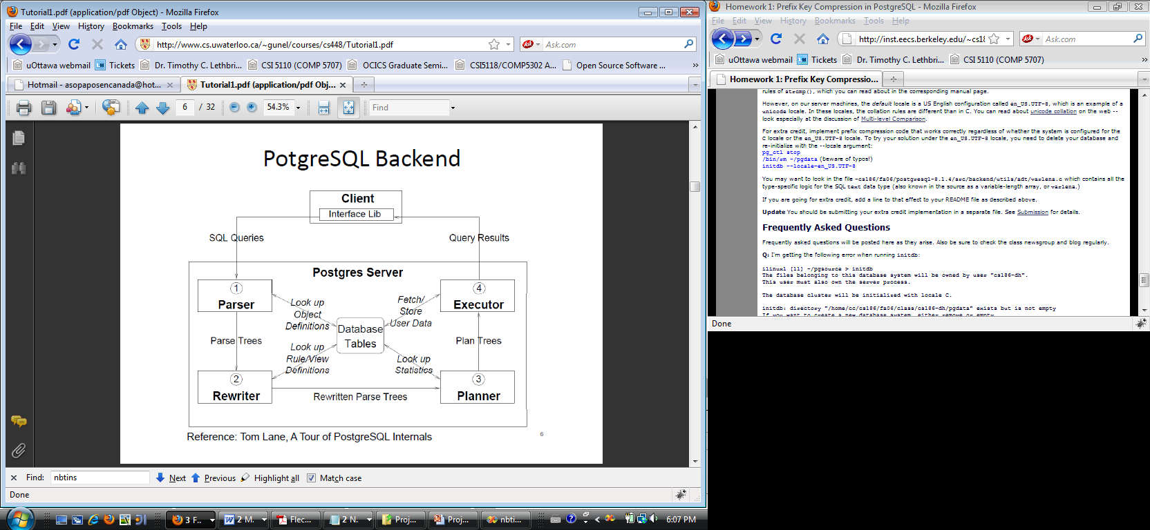

Slide 3
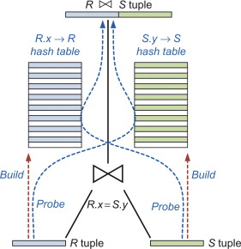
Symmetric / Pipeline Hash Join

Slide 4
Guidelines
Postgres SQL version 8.1.4 or 8.1.7
Group size of 4
Send group member details to lab TA’s latest by 08/11/2019
Refer to the files on the git repo: https://github.com/ferna11i/3130-DBMS
Files to change:
nodeHash.c
createplan.c
nodeHashjoin.c
execnodes.h

